Slide 1

Note: The data and information in this document is reflective of a hypothetical situation and client. This document is to be used for KPMG Virtual Internship purposes only.
Sprocket Central Pty Ltd
Data analytics approach
[Division Name] - [Engagement Manager], [Senior Consultant], [Junior Consultant]

Slide 2
Note: The data and information in this document is reflective of a hypothetical situation and client. This document is to be used for KPMG Virtual Internship purposes only.
Agenda
Introduction
Data Exploration
Model Development
Interpretation

Slide 3
Note: The data and information in this document is reflective of a hypothetical situation and client. This document is to be used for KPMG Virtual Internship purposes only.
Introduction
Optimizing Customer Value: Segmentation - 3-Week Timeline
To determine customer trends and identify the most valuable customer segments, we will use the existing 3 datasets (Customer demographic, customer address and transactions) as a labelled dataset and conduct a RFM analysis.
3 Phases: Data Exploration; Model Development and Interpretation.

Slide 4
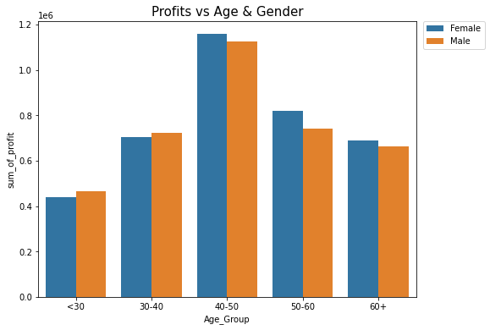
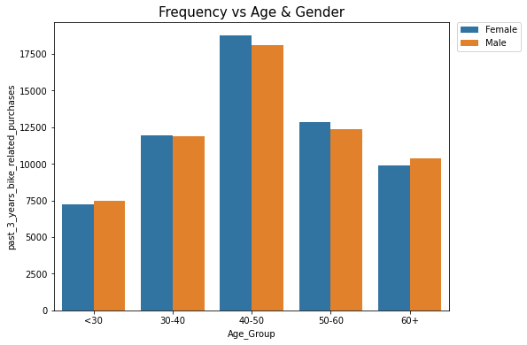
Note: The data and information in this document is reflective of a hypothetical situation and client. This document is to be used for KPMG Virtual Internship purposes only.
Data Exploration
Age & Gender Distribution
Data shows age group 40-50 has high count in terms of frequency (i.e. bike purchased in last 3 years) and monetary (i.e. sum of profits) with a slightly greater female ratio.
The target audience for our marketing and advertising should be inclined to provide focus on females customers in age 40-50.

Slide 5
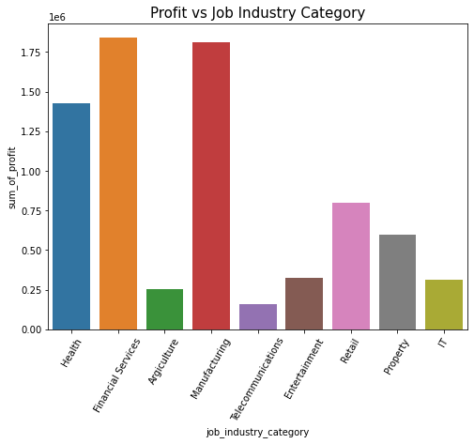
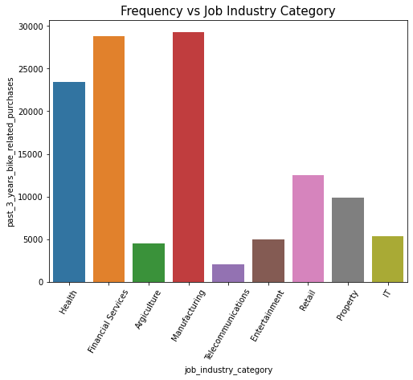
Note: The data and information in this document is reflective of a hypothetical situation and client. This document is to be used for KPMG Virtual Internship purposes only.
Data Exploration
Job Industry Category Distribution
Financial Services, Manufacturing, and Health are the top three profit-generating industries, followed by retail and property.
Financial Services, Manufacturing, and Health industries also rank as the most frequently purchased sectors.

Slide 6
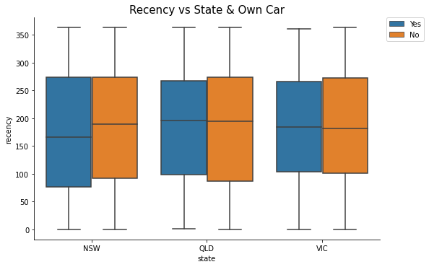
Note: The data and information in this document is reflective of a hypothetical situation and client. This document is to be used for KPMG Virtual Internship purposes only.
Data Exploration
State
Out of three states, New South Wales exhibits the greatest potential for increased marketing value to the company.
Customers in New South Wales who own cars have demonstrated the highest frequency of recent purchases, suggesting a slightly higher demand for bike-related products and a likelihood to make repeat purchases.

Slide 7
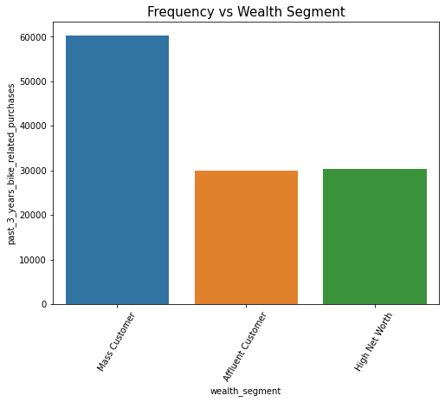
Note: The data and information in this document is reflective of a hypothetical situation and client. This document is to be used for KPMG Virtual Internship purposes only.
Data Exploration
Wealth Segment
Mass customer segment makes up nearly half of the daily bike purchasers in our customer base.

Slide 8
Note: The data and information in this document is reflective of a hypothetical situation and client. This document is to be used for KPMG Virtual Internship purposes only.
Model Development
Customer Segmentation – RFM Analysis
We compute RFM scores for our existing customers by factoring in the most recent transaction date, the total number of purchases made in the past 3 years, and the cumulative sum of profits.
Generating visualizations to delve deeper into data and segment customers based on the following criteria:
Classified as mass customers.
Age between 40 and 50. Slightly leaning towards female.
Employed in Financial Services, Manufacturing, and Health sectors.
Residing in New South Wales with their own cars.

Slide 9
Note: The data and information in this document is reflective of a hypothetical situation and client. This document is to be used for KPMG Virtual Internship purposes only.
Interpretation
Example of High-Value Customer Result
Customer ID | Past 3 Years Bike-Related Purchases | Age | Gender | Job Industry | Wealth Segment | Owns Cars | State
399 | 43 | 45 | Female | Health | Mass Customer | Yes | NSW
E.g. Past 3 Years Bike-Related Purchases - Frequency

Slide 10
Note: The data and information in this document is reflective of a hypothetical situation and client. This document is to be used for KPMG Virtual Internship purposes only.
Appendix

Slide 11
Note: The data and information in this document is reflective of a hypothetical situation and client. This document is to be used for KPMG Virtual Internship purposes only.
Appendix
This is an optional slide where you may place any supporting items.

